Slide 1


DATA COMMUNICATION CSE 225/233
WEEK-13, LESSON-1
CHANNELIZATION

Slide 2





Multiple Access
Channelization protocol
DISCUSSION POINTS
FDMA
TDMA CDMA
Data Communication Lecture Series, NRC, MAY2020

Slide 3


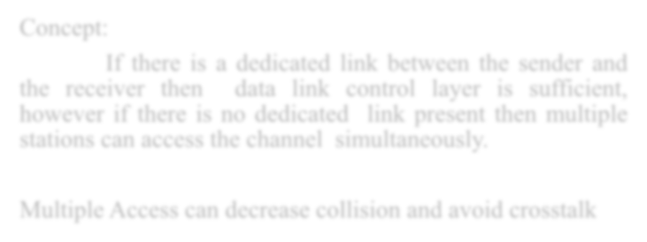

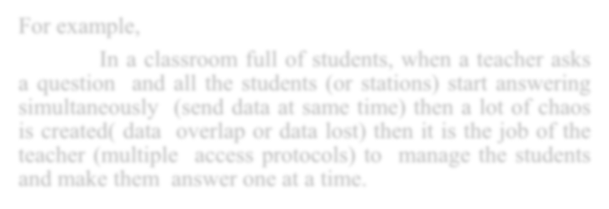
Concept:
If there is a dedicated link between the sender and
the receiver then data link control layer is sufficient,
MULTIPLE ACCESS
however if there is no dedicated link present then multiple
stations can access the channel simultaneously.
Multiple Access can decrease collision and avoid crosstalk
For example,
In a classroom full of students, when a teacher asks a question and all the students (or stations) start answering simultaneously (send data at same time) then a lot of chaos (disorder) is created ( data overlap or data lost) then it is the job of the teacher (multiple access protocols) to manage the students and make them answer one at a time.
Data Communication Lecture Series, NRC, MAY2020

Slide 4


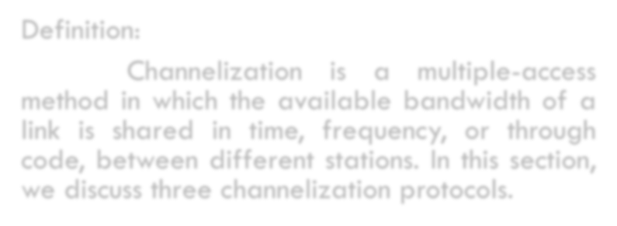


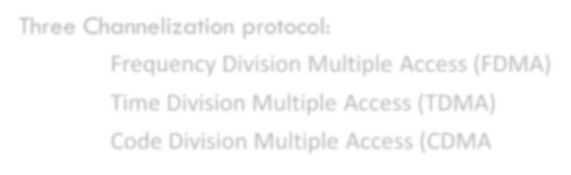
Definition:
Channelization is a multiple-access method in which the available bandwidth of a link is shared in time, frequency, or through code, among different stations. In this section, we discuss three channelization protocols.
CHANNELIZATION
Three Channelization protocol:
Frequency Division Multiple Access (FDMA)
Time Division Multiple Access (TDMA) Code Division Multiple Access (CDMA
Data Communication Lecture Series, NRC, MAY2020

Slide 5
Concept and Key Points:
FREQUENCY DIVISION MULTIPLE ACCESS(FDMA)
Available bandwidth is divided into frequency bands
Each station is allocated with a band to send its data
Each band is reserved for specific station all the time
Each station uses a bandpass filter to confine transmitter frequencies
In order to avoid station interferences, allocated bands are separated from one another by small guard bands.
Data Communication Lecture Series, NRC, MAY2020

Slide 6
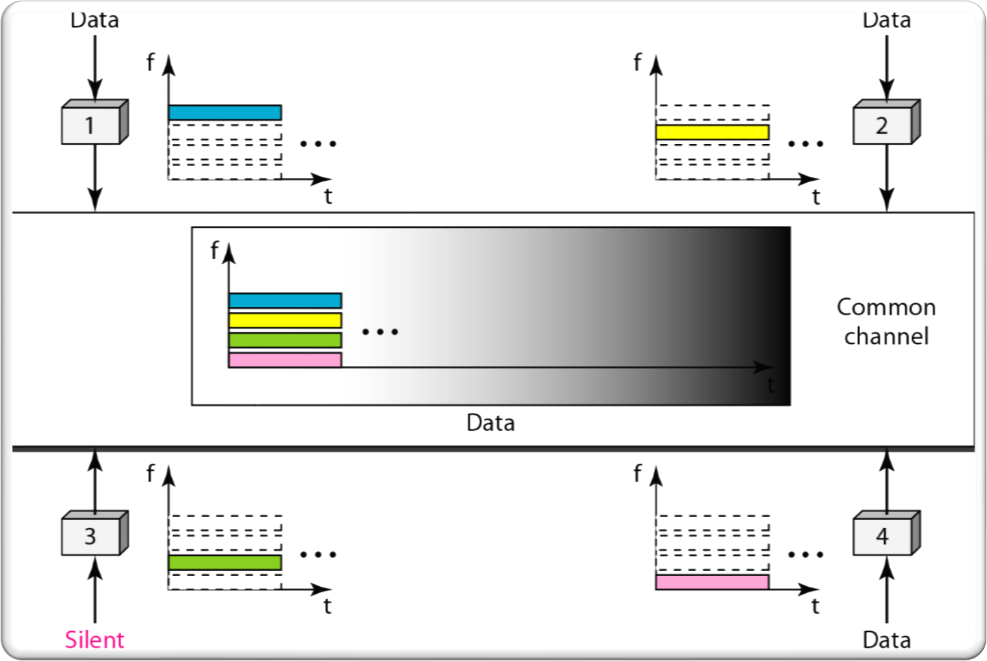
FDMA (CONTINUES)
FDMA SPECIFIES A PREDETERMINED FREQUENCY BAND FOR ENTIRE PERIOD OF COMMUNICATION
STREAM DATA (A CONTINUOUS FLOW OF DATA THAT MAY NOT BE PACKETIZED) CAN BE EASILY USED WITH FDMA.
Data Communication Lecture Series, NRC, MAY2020

Slide 7
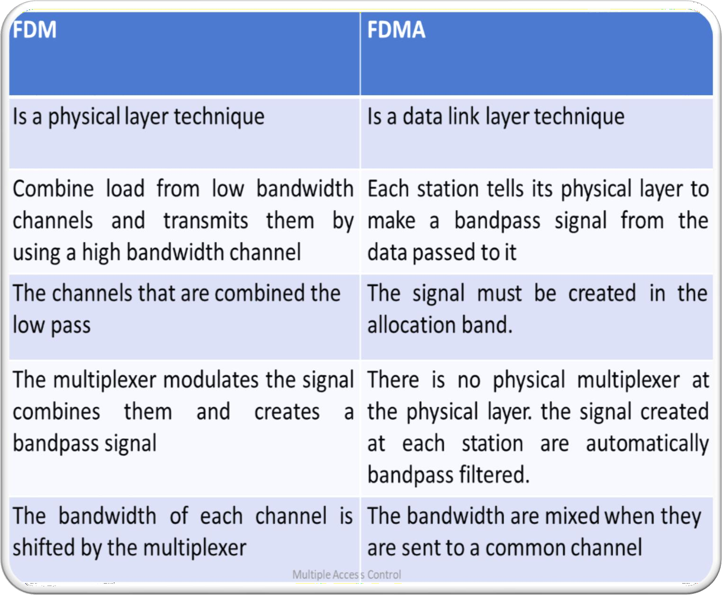
FDMA VS FDM
Data Communication Lecture Series, NRC, MAY2020

Slide 8



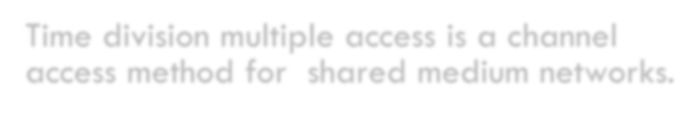


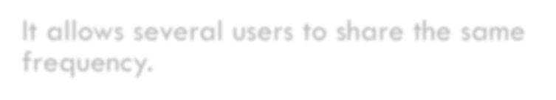

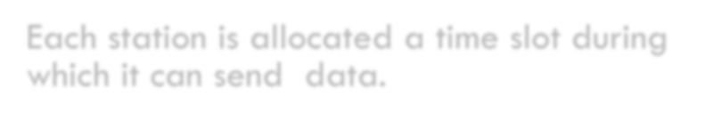

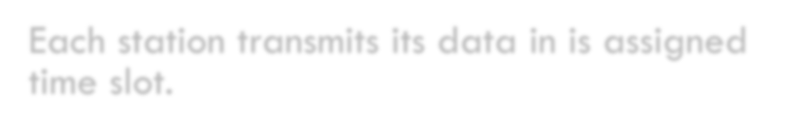

Concept and Key Points:
Time division multiple access is a channel access method for shared medium networks.
TIME DIVISION MULTIPLE ACCESS(TDMA)
It allows several users to share the same frequency.
Each station is allocated a time slot during which it can send data.
Each station transmits its data in is assigned time slot.
Data Communication Lecture Series, NRC, MAY2020

Slide 9
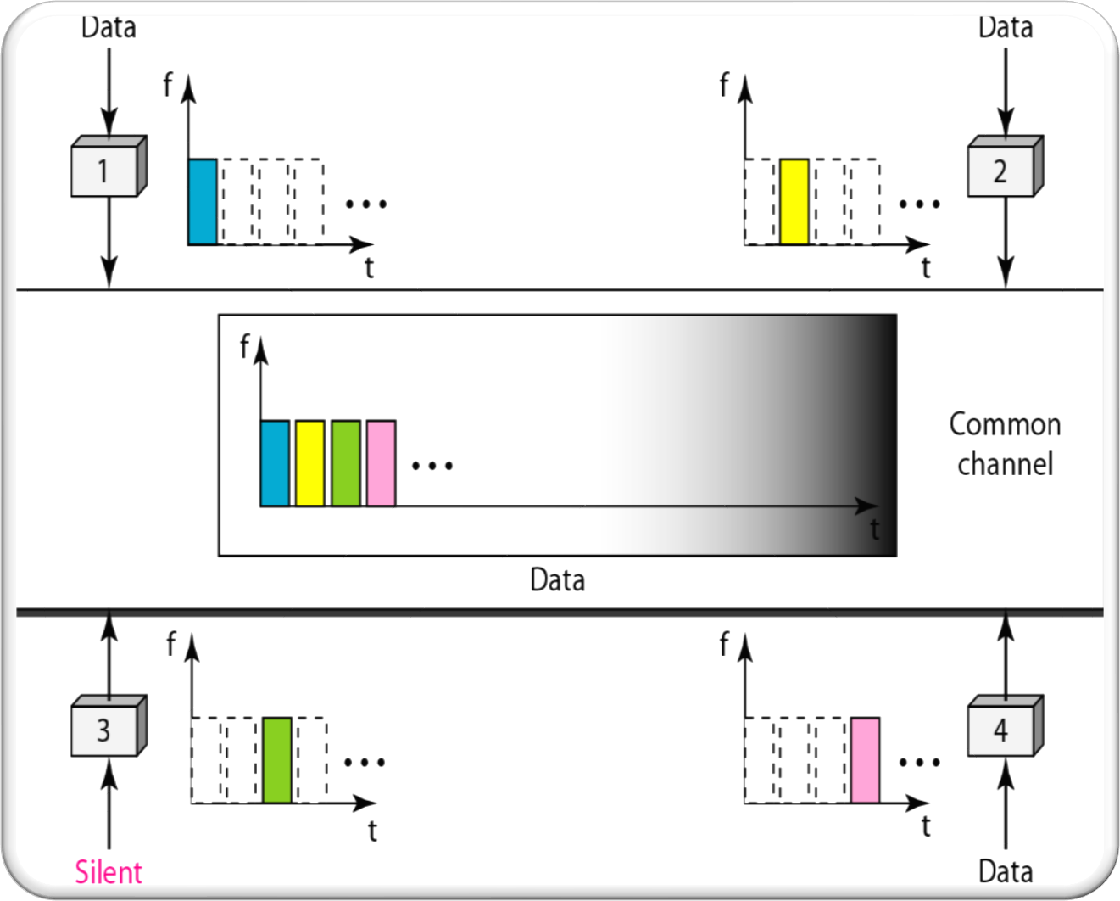
TDMA (CONTINUES)
The
lies
main problem with TDMA is
in achieving synchronization
between the different stations.
Each station needs to know the beginning of its slot and the location of its slot.
This is difficult
because delays
of introduced
propagation
in the system if the stations are
spread over large area.
To compensate this we insert guard times.
Data Communication Lecture Series, NRC, MAY2020

Slide 10


Code-division multiple access (CDMA) was conceived several decades ago. Recent advances in electronic technology have finally made its implementation possible.
CODE-DIVISION MULTIPLE ACCESS (CDMA)
CDMA differs from FDMA because only one channel occupies the entire bandwidth of the link.
It differs from TDMA because all stations can send data simultaneously; there is no timesharing

Slide 11


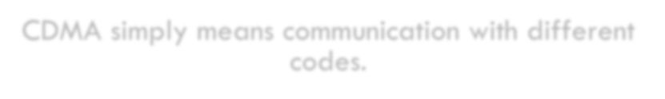



CDMA simply means communication with different codes.
CDMA (CONTD.) ANALOGY
For example,
In a large room with many people, two people can talk in Bengali if nobody else understands German.
Another two people can talk in French if they are the only ones who understand French, and so on. In other words, the common channel, the space of the room in this case, can easily allow communication between several people, but in different languages (codes).

Slide 12




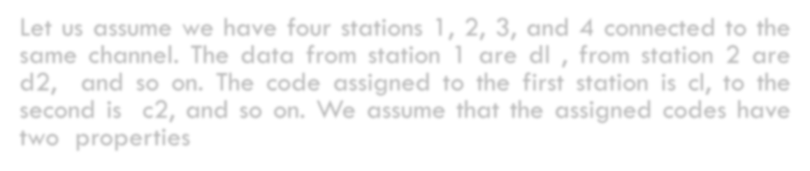
IDEA
Let us assume we have four stations 1, 2, 3, and 4 connected to the same channel. The data from station 1 are dl , from station 2 are d2, and so on. The code assigned to the first station is cI, to the second is c2, and so on. We assume that the assigned codes have two properties
If we multiply each code by another, we get O (zero).
If we multiply each code by itself, we get 4 (the number of stations).
12

Slide 13

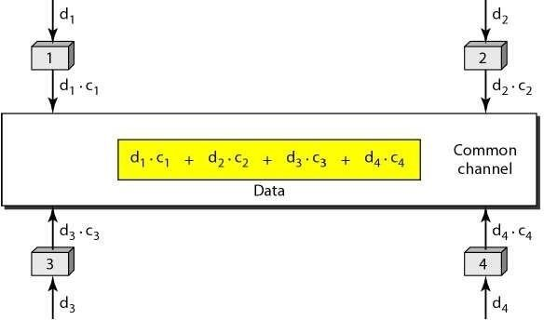
Station 1 multiplies its data by its code to get dl . Cl' Station 2 multiplies its data by its code to get d2
. c2' And so on.
The data that go on the channel are the sum of all these term. Any station that wants to receive data from one of the other three multiplies the data on the channel by the code of the sender.
For example, suppose stations 1 and 2 are talking to each other. Station 2 wants to hear what station I is saying. It multiplies the data on the channel by cl' the code of station 1.
Because (cl . cl) is 4, but (c2 . cI), (c3 . cI), and (c4 . cl) are all Os, station 2 divides the result by 4 to get the data from station 1.
data =(d) . Cj + dz . Cz +d3 . C3 + d4 . c4) . Cl
=d j . Cl . Cj +dz.Cz . Cl + d3 . C3 . Cl + d4 . C4' CI
=4 X d1
13

Slide 14
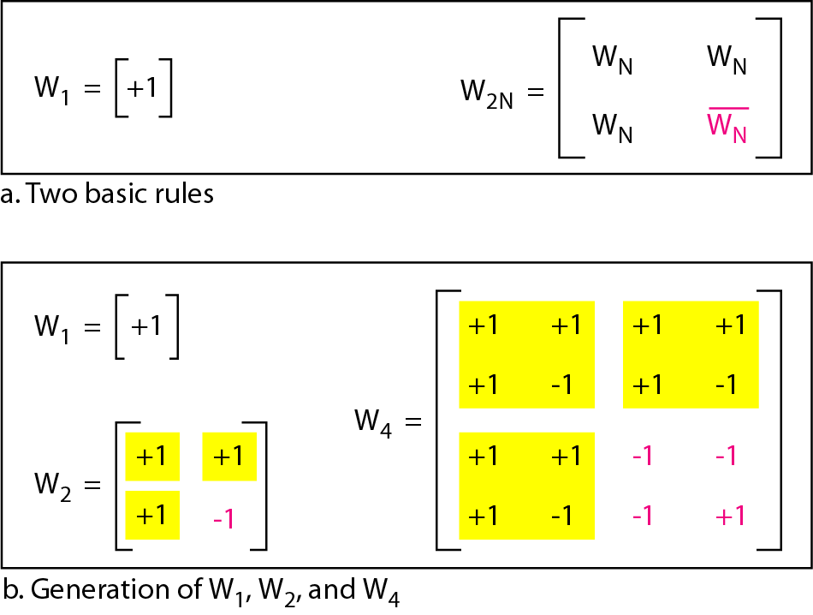
CHIPS
CDMA is based on Coding Theory. Each station is assigned a code, which is a sequence of numbers called chips.

Slide 15
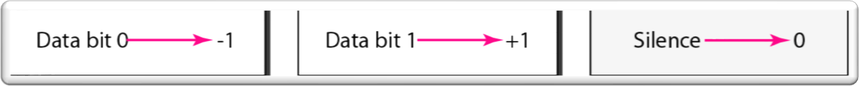
RULES OF ENCODING
IF STATION SENDS A 0 BIT, IT ENCODES IT AS -1
IF STATION SENDS A 1 BIT, IT ENCODES IT AS +1
WHEN A SYSTEM IS IDLE, IT SEND NO SIGNAL I.E. 0
DATA REPRESENTATION

Slide 16
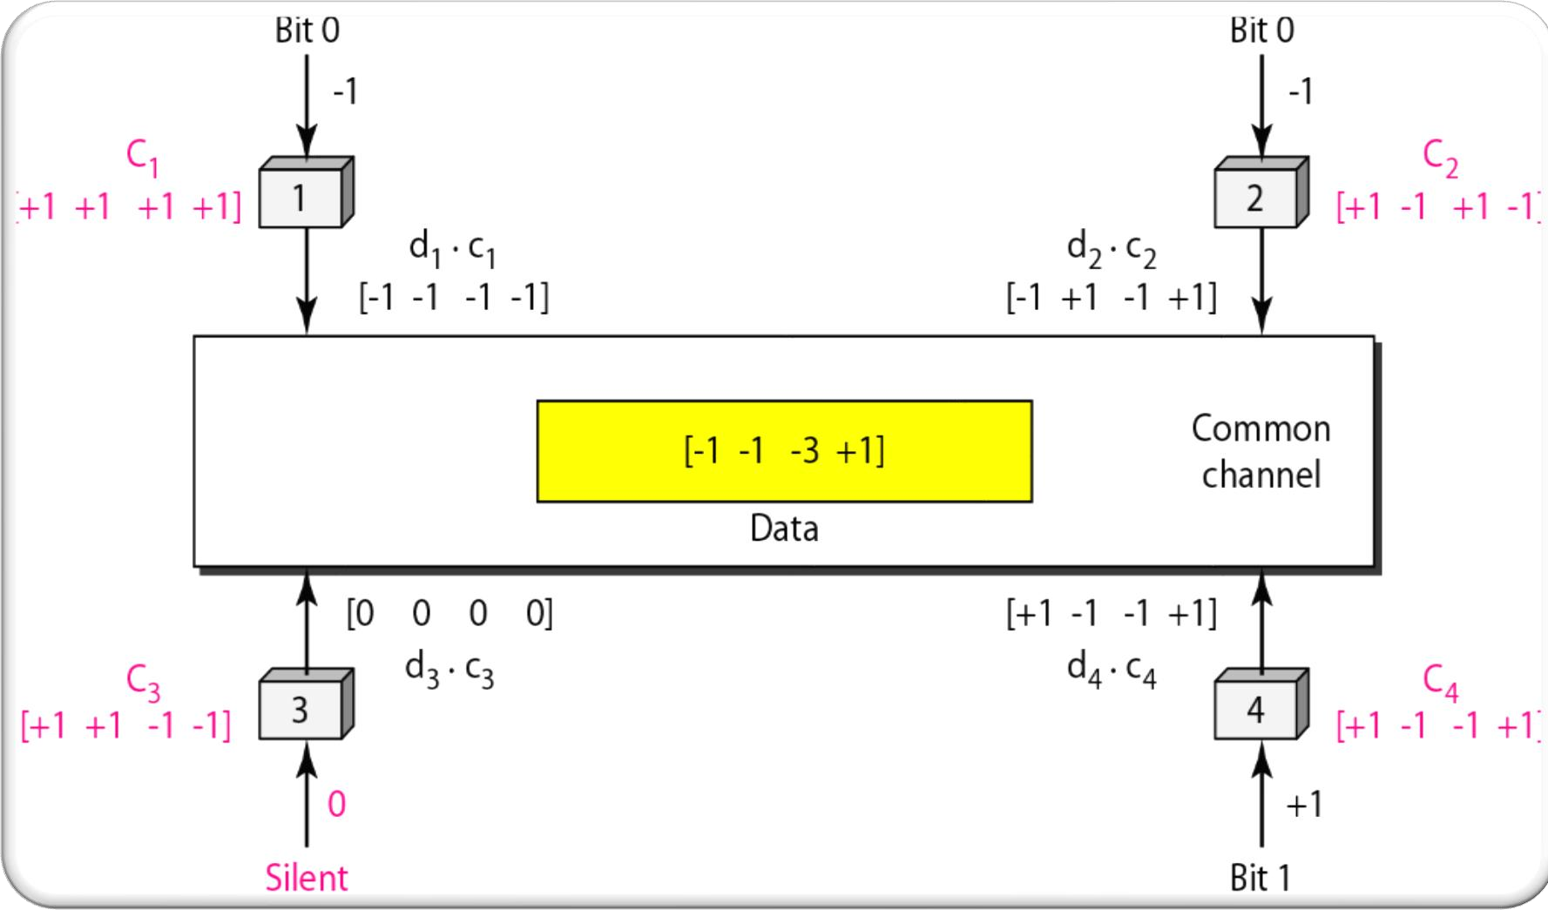
CDMA [ENCODING]

Slide 17
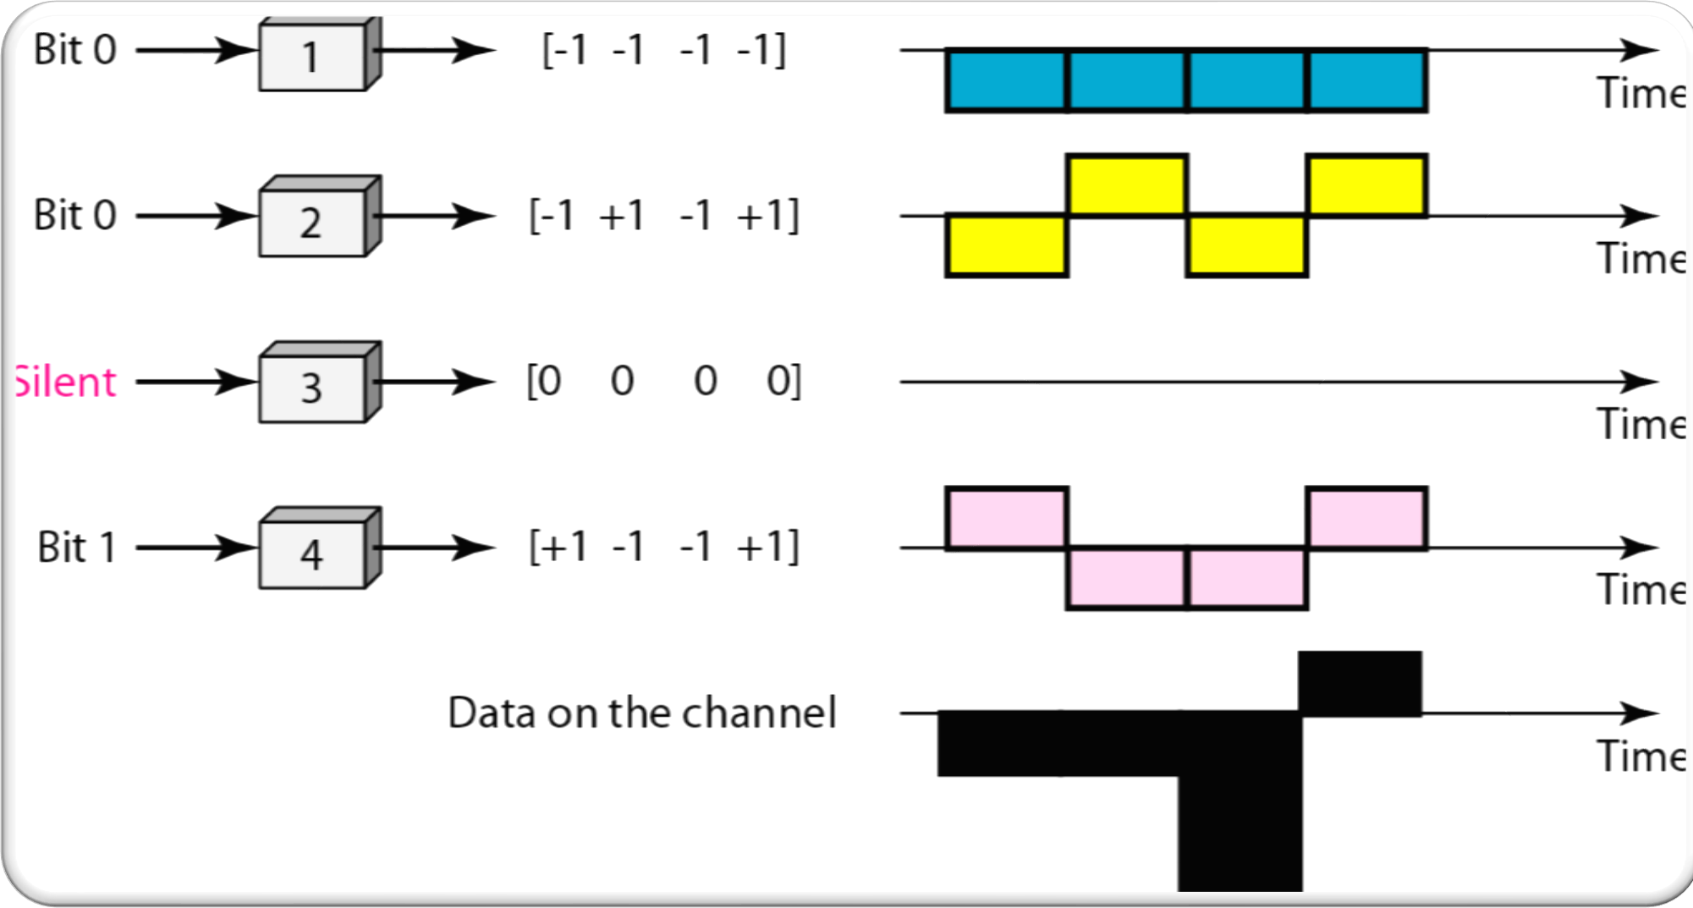
SIGNAL LEVEL

Slide 18
EXERCISE
FOLLOW THE EXERCISE GIVEN IN THE CHAPTER 12 OF OUR TEXT BOOK

Slide 19


